Slide 1
Shaping the future of AI from the history of Transformer
Hyung Won Chung
OpenAI
Twitter: @hwchung27
Notes:
AI is developing at such an overwhelming pace that it is hard to keep up. Instead of spending all our energy catching up with the latest development, I argue that we should study the change itself. First step is to identify and understand the driving force behind the change. For AI, it is the exponentially cheaper compute and associated scaling. I will provide a highly-opinionated view on the early history of Transformer architectures, focusing on what motivated each development and how each became less relevant with more compute. This analysis will help us connect the past and present in a unified perspective, which in turn makes it more manageable to project where the field is heading.
Let’s look into how we can shape the future of AI

Slide 2
AI is advancing so fast that it is hard to keep up
People spend a lot of time and energy catching up with the latest developments
But not enough attention goes to the old things
It is more important to study the change itself
Notes:
If I add “case study for transformer architecture”, then this slide can be outline

Slide 3
What does it mean to study the change itself?
1
Identify the dominant driving forces behind the change
Understand the dominant driving forces
Predict the future trajectory
2
3
Notes:
Why engage in the difficult activity of predicting the future?
Say increase the accuracy from 1% to 10%
Make 100 predictions
10 of them are right
1 of them can have outsized impact, overshadowing everything else.

Slide 4

Toy experiment: dropping a pen
1
Identify the dominant driving forces: gravity
Understand gravity: Newtonian mechanics provides a good model
Predict the future trajectory of the pen
2
3

Slide 5
Predicting the future trajectory is difficult because there are many driving forces and the complexity of their interactions
Prediction difficulty
Dropping a pen
Number of dominant driving forces
Notes:
I argue that AI research is probably close to the left hand side than it appears at the surface level because there is a dominant driving force.

Slide 6
Predicting the future trajectory is difficult because there are many driving forces and the complexity of their interactions
Prediction difficulty
Dropping a pen
Number of dominant driving forces
AI research is closer to the left than we feel
Notes:
I argue that AI research is probably close to the left hand side than it appears at the surface level because there is a dominant driving force.

Slide 7
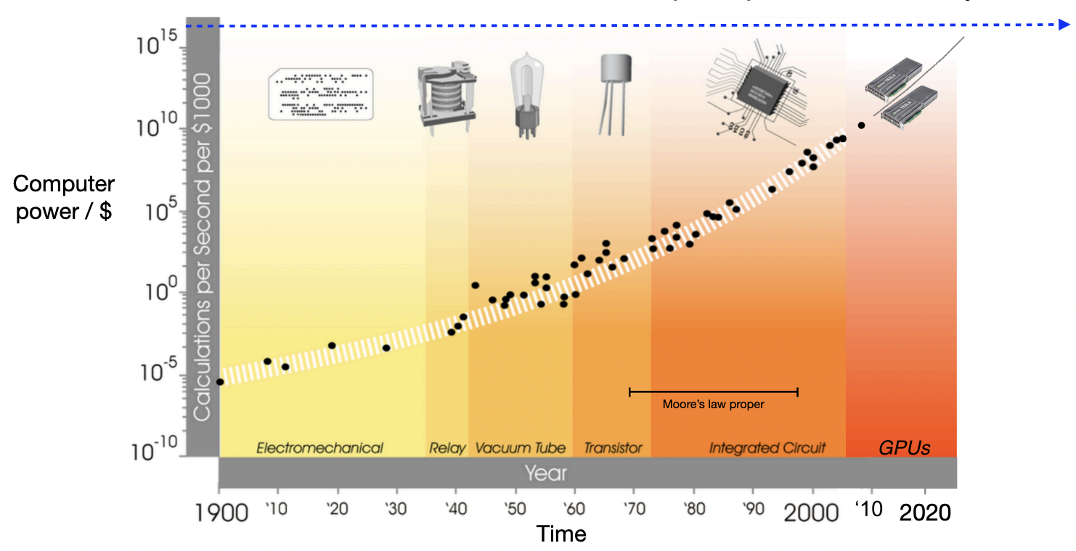
Brain-scale compute power
Roughly, 10x more compute every 5 years
Figure from Rich Sutton’s WAIC keynote
Notes:
We rarely see such an exponential trend over such a long period of time.

Slide 8
The job of AI researchers is to teach machines how to “think”
One (unfortunately common) approach
Teach the machines how we think we think
This approach poses structures to the problem, which can become the limitation when scaled up

Slide 9
The job of AI researchers is to teach machines how to “think”
Bitter lesson: progress of AI in the past 70 years boils down to
Develop progressively more general methods with weaker modeling assumptions
Add more data and computation (i.e. scale up)

Slide 10
The more structure, the less scalable the method is
Performance
Less structure
More structure
Compute
Notes:
Usually the more human input (e.g. modeling assumptions) the less scalable the method is
Compute is getting cheaper faster than we are becoming better researchers
An example is deep learning vs classical ML. Why did DL take off? It was more scalable. Why is it more scalable? Because it gives more degree of freedom (i.e. less structure) to the model.

Slide 11
However, we can’t just go for the most general method
Performance
Less structure
Even less structure
More structure
Compute
Inspired by the conversation with Beomjoon Kim
Notes:
Usually the more human input (e.g. modeling assumptions) the less scalable the method is
Compute is getting cheaper faster than we are becoming better researchers
An example is deep learning vs classical ML. Why did DL take off? It was more scalable. Why is it more scalable? Because it gives more degree of freedom (i.e. less structure) to the model.

Slide 12
However, we can’t just go for the most general method
Performance
Less structure
Even less structure
More structure
Compute
If we are here, we should choose “Less structure”. But remember to undo later
Inspired by the conversation with Beomjoon Kim
Notes:
Usually the more human input (e.g. modeling assumptions) the less scalable the method is
Compute is getting cheaper faster than we are becoming better researchers
An example is deep learning vs classical ML. Why did DL take off? It was more scalable. Why is it more scalable? Because it gives more degree of freedom (i.e. less structure) to the model.

Slide 13
However, we can’t just go for the most general method
Performance
Difference between the two methods is the additional “inductive biases” or structure imposed
Less structure
Even less structure
More structure
Compute
If we are here, we should choose “Less structure”. But remember to undo later
Inspired by the conversation with Beomjoon Kim
Notes:
Usually the more human input (e.g. modeling assumptions) the less scalable the method is
Compute is getting cheaper faster than we are becoming better researchers
An example is deep learning vs classical ML. Why did DL take off? It was more scalable. Why is it more scalable? Because it gives more degree of freedom (i.e. less structure) to the model.

Slide 14
Adding optimal inductive bias for a given level of compute, data, algorithmic development and architecture is critical
These are shortcuts that will hinder further scaling later on. Remove them later.
As a community we do the former well but not the latter

Slide 15
Implications of bitter lesson
What is better in the long term almost always looks worse now
This is somewhat unique to the AI research. If clever modeling techniques and fancy math were the driving force, it would have been completely different story

Slide 16
Summary
We identified the dominant driving force: exponentially cheaper compute and scaling
Now we need to understand it better
For that we will go to back to early history of Transformer and analyze key structures added by researchers and their motivations.
Then we will see how these structures became less relevant with now that more compute and better algorithm is available
1
2

Slide 17
Transformer architectures variants
Encoder-decoder
Encoder-only
Decoder-only (least structure)
Notes:
All of them are called transformers

Slide 18
Process
Shape
“Unicode characters like emojis may be split.”
[]

Slide 19
Process
Shape
[length]
[7085, 2456, 836, 470, 3975, 284, 530, 11241, 25, 773, 452, 12843, 13]
Tokenization
“Unicode characters like emojis may be split.”
[]

Slide 20
Process
Shape
2.3
4.5
…
3.8
-3.2
5.9
…
1.2
8.3
4.5
…
3.8
5.4
7.1
…
9.0
2.1
1.0
…
9.3
3.9
5.3
…
3.1
-8.9
5.0
…
4.2
3.8
3.1
…
0.8
3.9
0.7
…
9.2
3.3
5.0
…
5.8
[d_model, length]
Embedding
[length]
[7085, 2456, 836, 470, 3975, 284, 530, 11241, 25, 773, 452, 12843, 13]
Tokenization
“Unicode characters like emojis may be split.”
[]

Slide 21
Process
Shape
3.2
5.4
…
8.3
-2.3
9.5
…
2.1
3.8
5.4
…
8.3
4.5
1.7
…
0.9
1.2
0.1
…
3.9
9.3
3.5
…
1.3
-9.8
0.5
…
2.4
8.3
1.3
…
8.0
9.3
7.0
…
2.9
3.3
0.5
…
8.5
[d_model, length]
Sequence model
2.3
4.5
…
3.8
-3.2
5.9
…
1.2
8.3
4.5
…
3.8
5.4
7.1
…
9.0
2.1
1.0
…
9.3
3.9
5.3
…
3.1
-8.9
5.0
…
4.2
3.8
3.1
…
0.8
3.9
0.7
…
9.2
3.3
5.0
…
5.8
[d_model, length]
Embedding
[length]
[7085, 2456, 836, 470, 3975, 284, 530, 11241, 25, 773, 452, 12843, 13]
Tokenization
“Unicode characters like emojis may be split.”
[]

Slide 22
Encoder-decoder
Das
ist
gut
[EOS]
Cross attention only attends to the final layer activation
Output is a sequence
Decoder
Layer N
MLP
cross attention
Self-attention
Encoder
Layer N
MLP
Self-attention
Layer 1
Cross-attention connects encoder and decoder
Layer 1
Bidirectional self-attention
Causal self-attention
That
is
good
[BOS]
Das
ist
gut
Notes:
Historical context: at the time, translation was the main testbed for sequence models. Strong inductive bias that input and output are different enough that they should be modeled by separate set of parameters.
Separate encoder and decoder
Cross-attention only attends to the last encoder layer
Input is a sequence, output is a sequence, i.e. generation is possible

Slide 23
Encoder-decoder
Encoder
Layer 1
Bidirectional self-attention
That
is
good
Notes:
Historical context: at the time, translation was the main testbed for sequence models. Strong inductive bias that input and output are different enough that they should be modeled by separate set of parameters.
Separate encoder and decoder
Cross-attention only attends to the last encoder layer
Input is a sequence, output is a sequence, i.e. generation is possible

Slide 24
Encoder-decoder
Encoder
Layer N
MLP
Self-attention
Layer 1
Bidirectional self-attention
That
is
good
Notes:
Historical context: at the time, translation was the main testbed for sequence models. Strong inductive bias that input and output are different enough that they should be modeled by separate set of parameters.
Separate encoder and decoder
Cross-attention only attends to the last encoder layer
Input is a sequence, output is a sequence, i.e. generation is possible

Slide 25
Encoder-decoder
Decoder
Encoder
Layer N
MLP
Self-attention
Layer 1
Layer 1
Bidirectional self-attention
Causal self-attention
That
is
good
[BOS]
Das
ist
gut
Notes:
Historical context: at the time, translation was the main testbed for sequence models. Strong inductive bias that input and output are different enough that they should be modeled by separate set of parameters.
Separate encoder and decoder
Cross-attention only attends to the last encoder layer
Input is a sequence, output is a sequence, i.e. generation is possible

Slide 26
Encoder-decoder
Das
ist
gut
[EOS]
Output is a sequence
Decoder
Layer N
MLP
cross attention
Self-attention
Encoder
Layer N
MLP
Self-attention
Layer 1
Layer 1
Bidirectional self-attention
Causal self-attention
That
is
good
[BOS]
Das
ist
gut
Notes:
Historical context: at the time, translation was the main testbed for sequence models. Strong inductive bias that input and output are different enough that they should be modeled by separate set of parameters.
Separate encoder and decoder
Cross-attention only attends to the last encoder layer
Input is a sequence, output is a sequence, i.e. generation is possible

Slide 27
Encoder-decoder
Das
ist
gut
[EOS]
Output is a sequence
Decoder
Layer N
MLP
cross attention
Self-attention
Encoder
Layer N
MLP
Self-attention
Layer 1
Cross-attention connects encoder and decoder
Layer 1
Bidirectional self-attention
Causal self-attention
That
is
good
[BOS]
Das
ist
gut
Notes:
Historical context: at the time, translation was the main testbed for sequence models. Strong inductive bias that input and output are different enough that they should be modeled by separate set of parameters.
Separate encoder and decoder
Cross-attention only attends to the last encoder layer
Input is a sequence, output is a sequence, i.e. generation is possible

Slide 28
Encoder-decoder
Das
ist
gut
[EOS]
Cross attention only attends to the final layer activation
Output is a sequence
Decoder
Layer N
MLP
cross attention
Self-attention
Encoder
Layer N
MLP
Self-attention
Layer 1
Cross-attention connects encoder and decoder
Layer 1
Bidirectional self-attention
Causal self-attention
That
is
good
[BOS]
Das
ist
gut
Notes:
Historical context: at the time, translation was the main testbed for sequence models. Strong inductive bias that input and output are different enough that they should be modeled by separate set of parameters.
Separate encoder and decoder
Cross-attention only attends to the last encoder layer
Input is a sequence, output is a sequence, i.e. generation is possible

Slide 29
Encoder-only
Layer N
MLP
Self-attention
MLP
Layer 1
Self-attention
Input is a sequence
Prepend a special token
[CLS]
That
is
good
Notes:
Giving up on generation
GLUE came out a few months ago. So there was a huge focus on the NLU tasks in the community.

Slide 30
Encoder-only
Output is a single vector that encodes the input sequence
Layer N
MLP
Self-attention
MLP
Layer 1
Self-attention
Input is a sequence
Prepend a special token
[CLS]
That
is
good
Notes:
Giving up on generation
GLUE came out a few months ago. So there was a huge focus on the NLU tasks in the community.

Slide 31
Encoder-only
Task-specific layer is necessary to map output vector to classification label space
Positive
Negative
Task-specific
Linear layer
Output is a single vector that encodes the input sequence
Layer N
MLP
Self-attention
MLP
Layer 1
Self-attention
Input is a sequence
Prepend a special token
[CLS]
That
is
good
Notes:
Giving up on generation
GLUE came out a few months ago. So there was a huge focus on the NLU tasks in the community.

Slide 32
Encoder-only
Task-specific layer is necessary to map output vector to classification label space
Positive
Negative
Task-specific
Linear layer
Output is a single vector that encodes the input sequence
Layer N
Can’t generate a sequence!!
Deal breaker for general use case
MLP
Self-attention
MLP
Layer 1
Self-attention
Input is a sequence
Prepend a special token
[CLS]
That
is
good
Notes:
Giving up on generation
GLUE came out a few months ago. So there was a huge focus on the NLU tasks in the community.

Slide 33
Decoder-only
That
is
good
Das
ist
gut
[EOS]
Decoder
Layer N
MLP
Self-attention
Layer 1
[BOS]
That
is
good
Das
ist
gut
Notes:
Historical context: at the time, translation was the main testbed for sequence models. Strong inductive bias that input and output are different enough that they should be modeled by separate set of parameters.
Separate encoder and decoder
Cross-attention only attends to the last encoder layer
Input is a sequence, output is a sequence, i.e. generation is possible

Slide 34
Decoder-only
That
is
good
Das
ist
gut
[EOS]
Decoder
Layer N
MLP
Self-attention
Layer 1
Input and target are concatenated
[BOS]
That
is
good
Das
ist
gut
Notes:
Historical context: at the time, translation was the main testbed for sequence models. Strong inductive bias that input and output are different enough that they should be modeled by separate set of parameters.
Separate encoder and decoder
Cross-attention only attends to the last encoder layer
Input is a sequence, output is a sequence, i.e. generation is possible

Slide 35
Decoder-only
That
is
good
Das
ist
gut
[EOS]
Decoder
Layer N
MLP
Self-attention
Layer 1
Input and target are concatenated
[BOS]
That
is
good
Das
ist
gut
Notes:
Historical context: at the time, translation was the main testbed for sequence models. Strong inductive bias that input and output are different enough that they should be modeled by separate set of parameters.
Separate encoder and decoder
Cross-attention only attends to the last encoder layer
Input is a sequence, output is a sequence, i.e. generation is possible

Slide 36
Decoder-only
That
is
good
Das
ist
gut
[EOS]
Decoder
Output is a sequence
Layer N
MLP
Self-attention
Layer 1
Causal self-attention
Input and target are concatenated
[BOS]
That
is
good
Das
ist
gut
Notes:
Historical context: at the time, translation was the main testbed for sequence models. Strong inductive bias that input and output are different enough that they should be modeled by separate set of parameters.
Separate encoder and decoder
Cross-attention only attends to the last encoder layer
Input is a sequence, output is a sequence, i.e. generation is possible

Slide 37
Decoder-only
That
is
good
Das
ist
gut
[EOS]
Decoder
Output is a sequence
Layer N
Key design features
Self attention also serves the role of cross-attention
Same set of parameters apply to both input and target sequences
MLP
Self-attention
Layer 1
Causal self-attention
Input and target are concatenated
[BOS]
That
is
good
Das
ist
gut
Notes:
Historical context: at the time, translation was the main testbed for sequence models. Strong inductive bias that input and output are different enough that they should be modeled by separate set of parameters.
Separate encoder and decoder
Cross-attention only attends to the last encoder layer
Input is a sequence, output is a sequence, i.e. generation is possible

Slide 38
How different are encoder-decoder and decoder-only architectures?
Let’s try to transform encoder-decoder into decoder-only

Slide 39
Summary of the differences
 | Encoder-decoder | Decoder-only
Additional cross attention
Parameter sharing
Target-to-input attention pattern
Input attention

Slide 40
Das
ist
gut
[EOS]
That
is
good
Das
ist
gut
[EOS]
Decoder
Layer N
Decoder
MLP
Layer N
cross attention
MLP
Self-attention
Self-attention
Encoder
Layer N
MLP
Self-attention
Layer 1
Layer 1
Layer 1
[BOS]
That
is
good
Das
ist
gut
That
is
good
[BOS]
Das
ist
gut
Notes:
Historical context: at the time, translation was the main testbed for sequence models. Strong inductive bias that input and output are different enough that they should be modeled by separate set of parameters.
Separate encoder and decoder
Cross-attention only attends to the last encoder layer
Input is a sequence, output is a sequence, i.e. generation is possible

Slide 41
1. Share cross and self-attention parameters
Das
ist
gut
[EOS]
That
is
good
Das
ist
gut
[EOS]
Decoder
Layer N
Decoder
MLP
Layer N
cross attention
MLP
Self-attention
Self-attention
Encoder
Layer N
MLP
Self-attention
Layer 1
Layer 1
Layer 1
[BOS]
That
is
good
Das
ist
gut
That
is
good
[BOS]
Das
ist
gut
Notes:
Historical context: at the time, translation was the main testbed for sequence models. Strong inductive bias that input and output are different enough that they should be modeled by separate set of parameters.
Separate encoder and decoder
Cross-attention only attends to the last encoder layer
Input is a sequence, output is a sequence, i.e. generation is possible

Slide 42
Summary of the differences
 | Encoder-decoder | Decoder-only
Additional cross attention | Separate cross attention | Self-attention serving both roles
Parameter sharing
Target-to-input attention pattern
Input attention

Slide 43
Das
ist
gut
[EOS]
That
is
good
Das
ist
gut
[EOS]
Decoder
Layer N
Decoder
MLP
Layer N
cross attention
MLP
Self-attention
Self-attention
Encoder
Layer N
MLP
Self-attention
Layer 1
Layer 1
Layer 1
[BOS]
That
is
good
Das
ist
gut
That
is
good
[BOS]
Das
ist
gut
Notes:
Historical context: at the time, translation was the main testbed for sequence models. Strong inductive bias that input and output are different enough that they should be modeled by separate set of parameters.
Separate encoder and decoder
Cross-attention only attends to the last encoder layer
Input is a sequence, output is a sequence, i.e. generation is possible

Slide 44
2. Share encoder and decoder parameters
Das
ist
gut
[EOS]
That
is
good
Das
ist
gut
[EOS]
Decoder
Layer N
Decoder
MLP
Layer N
cross attention
MLP
Self-attention
Self-attention
Encoder
Layer N
MLP
Self-attention
Layer 1
Layer 1
Layer 1
[BOS]
That
is
good
Das
ist
gut
That
is
good
[BOS]
Das
ist
gut
Notes:
Historical context: at the time, translation was the main testbed for sequence models. Strong inductive bias that input and output are different enough that they should be modeled by separate set of parameters.
Separate encoder and decoder
Cross-attention only attends to the last encoder layer
Input is a sequence, output is a sequence, i.e. generation is possible

Slide 45
Summary of the differences
 | Encoder-decoder | Decoder-only
Additional cross attention | Separate cross attention | Self-attention serving both roles
Parameter sharing | Separate parameters for input and target | Shared parameters
Target-to-input attention pattern
Input attention

Slide 46
Das
ist
gut
[EOS]
That
is
good
Das
ist
gut
[EOS]
Decoder
Layer N
Decoder
MLP
Layer N
cross attention
MLP
Self-attention
Self-attention
Encoder
Layer N
MLP
Self-attention
Layer 1
Layer 1
Layer 1
[BOS]
That
is
good
Das
ist
gut
That
is
good
[BOS]
Das
ist
gut
Notes:
Historical context: at the time, translation was the main testbed for sequence models. Strong inductive bias that input and output are different enough that they should be modeled by separate set of parameters.
Separate encoder and decoder
Cross-attention only attends to the last encoder layer
Input is a sequence, output is a sequence, i.e. generation is possible

Slide 47
3. Decoder layer l attends to encoder layer l
Das
ist
gut
[EOS]
That
is
good
Das
ist
gut
[EOS]
Decoder
Layer N
Decoder
MLP
Layer N
cross attention
MLP
Self-attention
Self-attention
Encoder
Layer N
MLP
Self-attention
Layer 1
Layer 1
Layer 1
[BOS]
That
is
good
Das
ist
gut
That
is
good
[BOS]
Das
ist
gut
Notes:
Historical context: at the time, translation was the main testbed for sequence models. Strong inductive bias that input and output are different enough that they should be modeled by separate set of parameters.
Separate encoder and decoder
Cross-attention only attends to the last encoder layer
Input is a sequence, output is a sequence, i.e. generation is possible

Slide 48
Summary of the differences
 | Encoder-decoder | Decoder-only
Additional cross attention | Separate cross attention | Self-attention serving both roles
Parameter sharing | Separate parameters for input and target | Shared parameters
Target-to-input attention pattern | Only attends to the last layer of encoder’s output | Within-layer (i.e. layer l attends to layer l)
Input attention
* input attention can be bidirectional

Slide 49
Das
ist
gut
[EOS]
That
is
good
Das
ist
gut
[EOS]
Decoder
Layer N
Decoder
MLP
Layer N
cross attention
MLP
Self-attention
Self-attention
Encoder
Layer N
MLP
Self-attention
Layer 1
Layer 1
Layer 1
[BOS]
That
is
good
Das
ist
gut
That
is
good
[BOS]
Das
ist
gut
Notes:
Historical context: at the time, translation was the main testbed for sequence models. Strong inductive bias that input and output are different enough that they should be modeled by separate set of parameters.
Separate encoder and decoder
Cross-attention only attends to the last encoder layer
Input is a sequence, output is a sequence, i.e. generation is possible

Slide 50
4. Make encoder self-attention causal
Das
ist
gut
[EOS]
That
is
good
Das
ist
gut
[EOS]
Decoder
Layer N
Decoder
MLP
Layer N
cross attention
MLP
Self-attention
Self-attention
Encoder
Layer N
MLP
Self-attention
Layer 1
Layer 1
Layer 1
[BOS]
That
is
good
Das
ist
gut
That
is
good
[BOS]
Das
ist
gut
Notes:
Historical context: at the time, translation was the main testbed for sequence models. Strong inductive bias that input and output are different enough that they should be modeled by separate set of parameters.
Separate encoder and decoder
Cross-attention only attends to the last encoder layer
Input is a sequence, output is a sequence, i.e. generation is possible

Slide 51
Summary of the differences
 | Encoder-decoder | Decoder-only
Additional cross attention | Separate cross attention | Self-attention serving both roles
Parameter sharing | Separate parameters for input and target | Shared parameters
Target-to-input attention pattern | Only attends to the last layer of encoder’s output | Within-layer (i.e. layer l attends to layer l)
Input attention | Bidirectional | Unidirectional*
* input attention can be bidirectional

Slide 52
Additional structures in encoder-decoder compared to decoder-only
Input and target sequences are sufficiently different that using separate parameters can be effective
The target element can attend to the fully encoded representation of the input
When encoding the input sequence, all-to-all interaction among the sequence elements is preferred

Slide 53
Additional structures in encoder-decoder compared to decoder-only
Input and target sequences are sufficiently different that using separate parameters can be effective
The target element can attend to the fully encoded representation of the input
When encoding the input sequence, all-to-all interaction among the sequence elements is preferred

Slide 54
Example 1: machine translation
Das
ist
gut
[EOS]
When Transformer was introduced in 2017, translation was a popular and difficult task
Input and target are in different languages
If the only goal is to learn translation, separate parameters make sense
Decoder
Layer N
MLP
cross attention
Self-attention
Encoder
Layer N
MLP
Self-attention
Layer 1
Layer 1
That
is
good
[BOS]
Das
ist
gut
Source language
Target language
Notes:
Language model is not about learning language. It is about learning the world knowledge. It happens that many of them are in textual form and we know how to handle them well.
If MT is the final goal, it makes sense to impose a structure that facilitates that. However, at larger scale, we do care more about general knowledge including MT. Knowledge exist in data that can be in multiple languages. Parameters shared across languages makes more sense because that may facilitates combining knowledge that exist in different languages.

Slide 55
Example 1: machine translation
Das
ist
gut
[EOS]
When Transformer was introduced in 2017, translation was a popular and difficult task
Input and target are in different languages
If the only goal is to learn translation, separate parameters make sense
Modern language models learn the world knowledge
Separate parameters for knowledge just expressed in different languages? 🤔
Decoder
Layer N
MLP
cross attention
Self-attention
Encoder
Layer N
MLP
Self-attention
Layer 1
Layer 1
That
is
good
[BOS]
Das
ist
gut
Source language
Target language
Notes:
Language model is not about learning language. It is about learning the world knowledge. It happens that many of them are in textual form and we know how to handle them well.
If MT is the final goal, it makes sense to impose a structure that facilitates that. However, at larger scale, we do care more about general knowledge including MT. Knowledge exist in data that can be in multiple languages. Parameters shared across languages makes more sense because that may facilitates combining knowledge that exist in different languages.

Slide 56
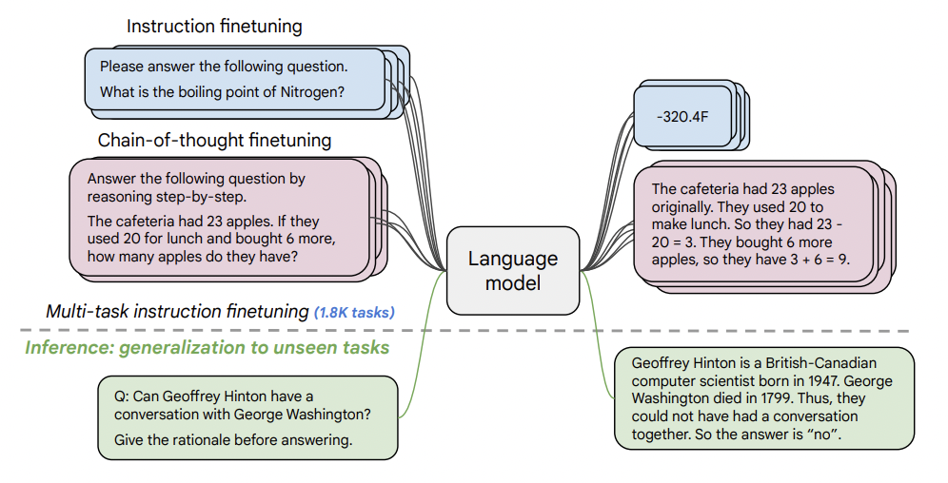
Example 2: instruction finetuning with academic datasets
Scaling Instruction-Finetuned Language Models
Hyung Won Chung, Le Hou, Shayne Longpre, Barret Zoph, Yi Tay, William Fedus et al. (2022)

Slide 57
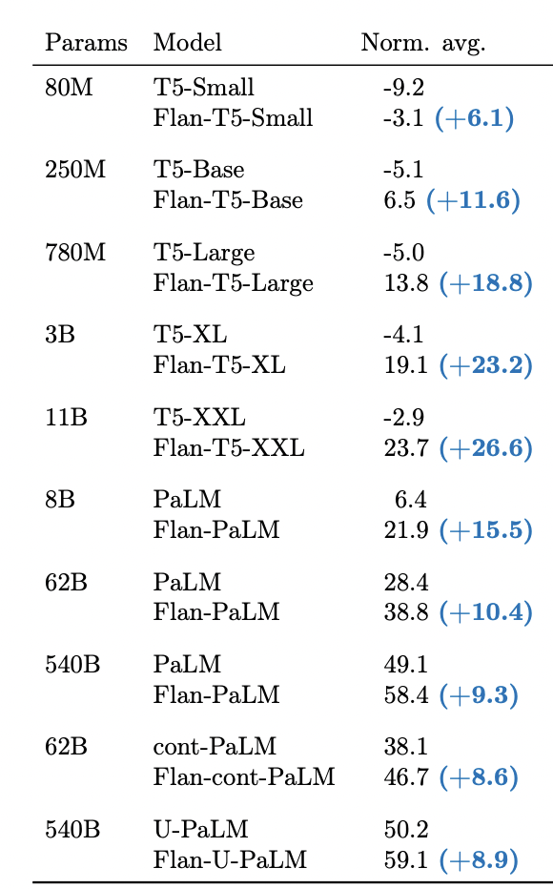
Example 2: instruction finetuning with academic datasets
Encoder-decoder
Encoder-decoder models had much bigger gain!
Decoder-only

Slide 58
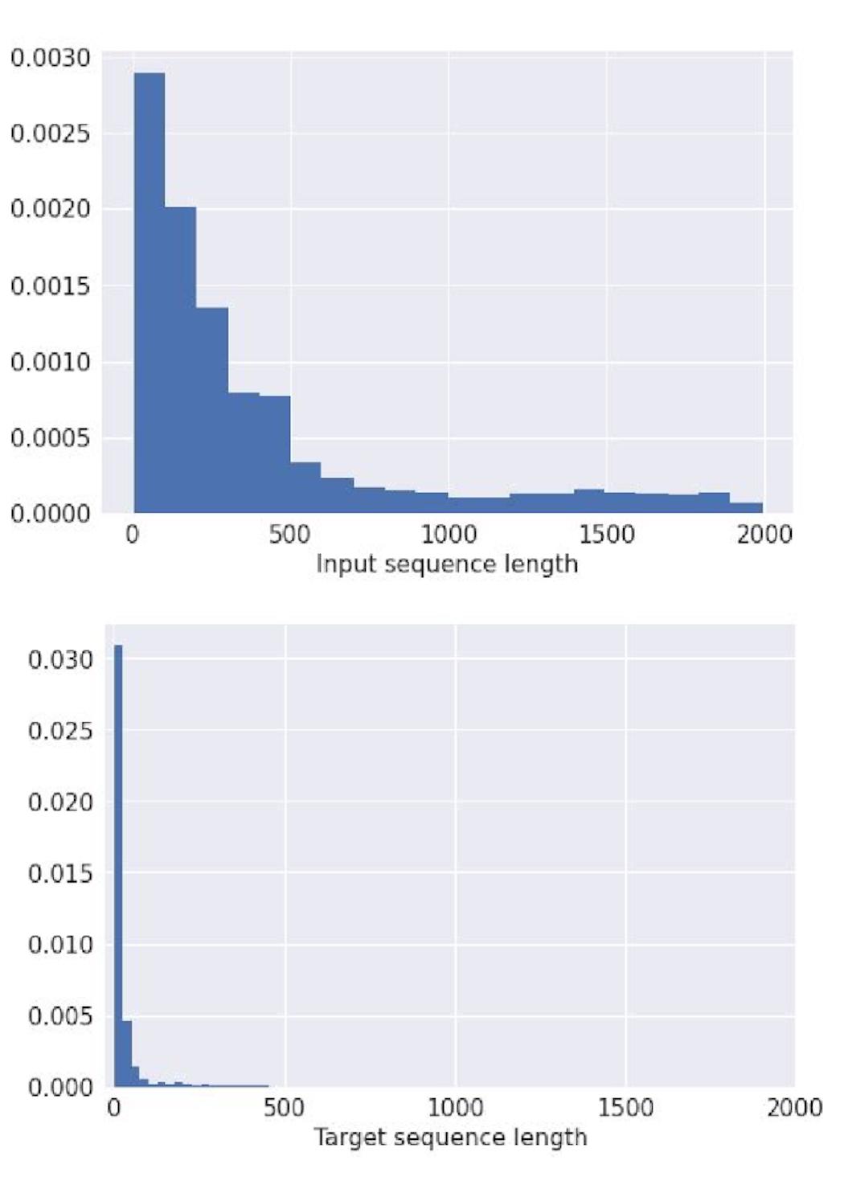
Example 2: instruction finetuning with academic datasets
Academic datasets have distinctive length distribution: long input and short target
This is due to inherent difficulty of grading long text
Hypothesis
Having separate parameters for longer text in input and shorter text in target was an effective structure
No longer a good structure as more interesting language model use cases have longer generation
Length distribution of finetuning datasets

Slide 59
Additional structures in encoder-decoder compared to decoder-only
Input and target sequences are sufficiently different that using separate parameters can be effective
The target element can attend to the fully encoded representation of the input
When encoding the input sequence, all-to-all interaction among the sequence elements is preferred

Slide 60
Cross attention only attends to the final layer activation
Das
ist
gut
[EOS]
That
is
good
Das
ist
gut
[EOS]
Decoder
Layer N
Decoder
MLP
Layer N
cross attention
MLP
Self-attention
Self-attention
Encoder
Layer N
MLP
Self-attention
Layer 1
Layer 1
Layer 1
[BOS]
That
is
good
Das
ist
gut
That
is
good
[BOS]
Das
ist
gut
Notes:
Historical context: at the time, translation was the main testbed for sequence models. Strong inductive bias that input and output are different enough that they should be modeled by separate set of parameters.
Separate encoder and decoder
Cross-attention only attends to the last encoder layer
Input is a sequence, output is a sequence, i.e. generation is possible

Slide 61
In deep neural networks, the bottom and top layers encode information at a different level of granularity
For example, in computer vision, the bottom layers learn to encode edges and the top layers learn higher level features (e.g. cat face)
Can decoder only attending to the final layer of encoder be an information bottleneck if encoder is sufficiently deep? 🤔

Slide 62
Additional structures in encoder-decoder compared to decoder-only
Input and target sequences are sufficiently different that using separate parameters can be effective
The target element can attend to the fully encoded representation of the input
When encoding the input sequence, all-to-all interaction among the sequence elements is preferred

Slide 63
Das
ist
gut
[EOS]
That
is
good
Das
ist
gut
[EOS]
Decoder
Layer N
Decoder
MLP
Layer N
cross attention
MLP
Self-attention
Self-attention
Encoder
Layer N
MLP
Self-attention
Layer 1
Layer 1
Layer 1
Bidirectional
[BOS]
That
is
good
Das
ist
gut
That
is
good
[BOS]
Das
ist
gut
Notes:
Historical context: at the time, translation was the main testbed for sequence models. Strong inductive bias that input and output are different enough that they should be modeled by separate set of parameters.
Separate encoder and decoder
Cross-attention only attends to the last encoder layer
Input is a sequence, output is a sequence, i.e. generation is possible

Slide 64
(Highly anecdotal) At sufficient scale, bidirectionality doesn’t seem to matter much
Bidirectionality brings in engineering challenges for multi-turn chat application
At every turn, the new input has to be encoded again; for unidirectional attention, only the newly added message needs to be encoded.

Slide 65
Input attention pattern for multi-turn conversation
Bidirectional
USER
How are you?
ASSISTANT
Bad
USER
Why?
How
are
you?
How
are
you?
Bad

Slide 66
Input attention pattern for multi-turn conversation
Bidirectional
Unidirectional
USER
How are you?
ASSISTANT
Bad
USER
Why?
How
are
you?
How
are
you?
How
are
you?
Bad
How
are
you?
Bad

Slide 67
Conclusion
Identify the dominant driving force as exponentially cheaper compute and associated scaling
Analyzed additional structure of encoder-decoder from the perspective of scaling
Hopefully this perspective and analysis can be useful for understanding what is happening today and predict the future trajectory

